Slide 1
Threads
Course Instructor
Anam Akbar

Slide 2
Threads
Types of Threads
User Level Threads: User managed threads
Kernel level Threads: Operating System managed threads acting on kernel, an operating system core.
User Level Threads
The thread management kernel is not aware of the existence of user level threads.
The thread library contains code for creating and destroying threads
for passing message and data between threads,
for scheduling thread execution and
for saving and restoring thread contexts.
The application starts with a single thread.

Slide 3
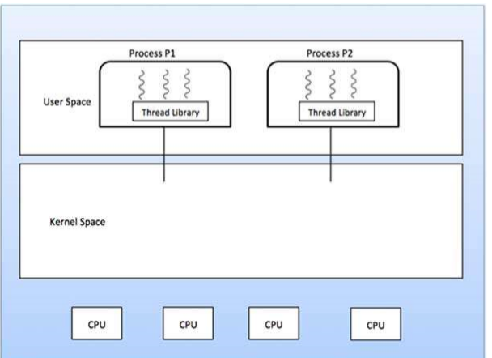
Threads

Slide 4
Threads
Advantages
Thread switching does not require Kernel mode privileges.
User level thread can run on any operating system.
Scheduling can be application specific in the user level thread.
User level threads are fast to create and manage.
Disadvantages
In a typical operating system, most system calls are blocking.
Multithreaded application cannot take advantage of multiprocessing.

Slide 5
Threads
Thread management is done by the Kernel.
There is no thread management code in the application area
Kernel threads are supported directly by the operating system
Any application can be programmed to be multithreaded
All of the threads within an application are supported within a single process
The Kernel maintains context information for the process as a whole and for individuals threads within the process.
Scheduling by the Kernel is done on a thread basis
The Kernel performs thread creation, scheduling and management in Kernel space.
Kernel threads are generally slower to create and manage than the user threads.

Slide 6
Threads
Advantages
Kernel can simultaneously schedule multiple threads from the same process on multiple processes.
If one thread in a process is blocked, the Kernel can schedule another thread of the same process.
Kernel routines themselves can be multithreaded.
Disadvantages
Kernel threads are generally slower to create and manage than the user threads.
Transfer of control from one thread to another within the same process requires a mode switch to the Kernel

Slide 7
Threads
Multithreading Models
Some operating system provide a combined user level thread and Kernel level thread facility.
Solaris is a good example of this combined approach.
In a combined system, multiple threads within the same application can run in parallel on multiple processors and a blocking system call need not block the entire process.
Multithreading models are three types
Many-to-many relationship
Many-to-one relationship
One-to-one relationship

Slide 8
Threads
Many-to-Many Model
The many-to-many model multiplexes any number of user threads onto an equal or smaller number of kernel threads.
In this model, developers can create as many user threads as necessary and the corresponding Kernel threads can run in parallel on a multiprocessor machine.
This model provides the best accuracy on concurrency and when a thread performs a blocking system call, the kernel can schedule another thread for execution.

Slide 9
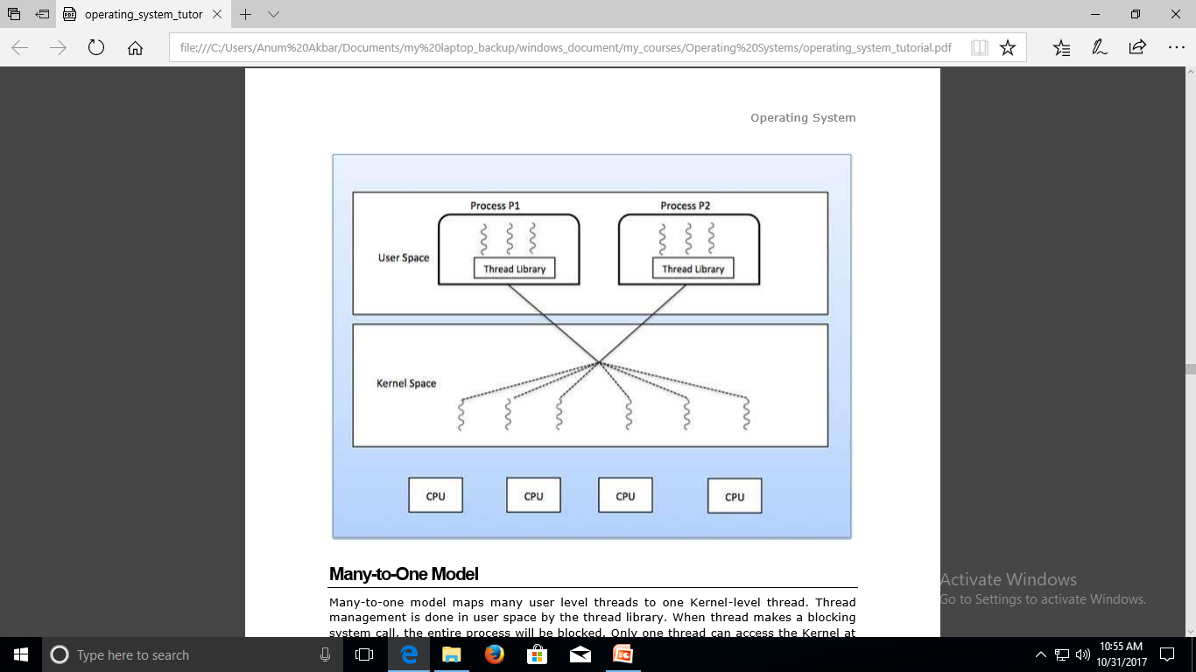
Threads

Slide 10
Threads
Many-to-One Model
Many-to-one model maps many user level threads to one Kernel-level thread.
Thread management is done in user space by the thread library. When thread makes a blocking system call, the entire process will be blocked.
Only one thread can access the Kernel at a time, so multiple threads are unable to run in parallel on multiprocessors.
If the user-level thread libraries are implemented in the operating system in such a way that the system does not support them, then the Kernel threads use the many-to-one relationship modes.

Slide 11
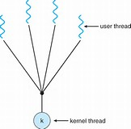
Threads

Slide 12
Threads
One-to-One Model
There is one-to-one relationship of user-level thread to the kernel-level thread.
This model provides more concurrency than the many-to-one model.
It also allows another thread to run when a thread makes a blocking system call.
It supports multiple threads to execute in parallel on microprocessors.
Disadvantage of this model is that creating user thread requires the corresponding Kernel thread.
OS/2, windows NT and windows 2000 use one to one relationship model.

Slide 13
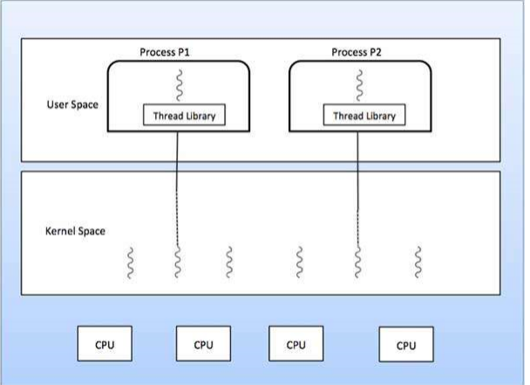
Threads

